Slide 1


MODEL SETUP I WORKSHOP
UNCLASSIFIED
Lauren Melendez
U.S. Army Engineer Research and Development Center, Environmental Laboratory
CE-QUAL-W2 Workshop
July 08 – 09, 2024
Environmental Systems Modeling Team
UNCLASSIFIED

Slide 2

Outline
Background
Definition of problem
Required Information
Bathymetry
Flow
Meteorology
Observations
Other
Output
Detroit Dam, Oregon

Slide 3
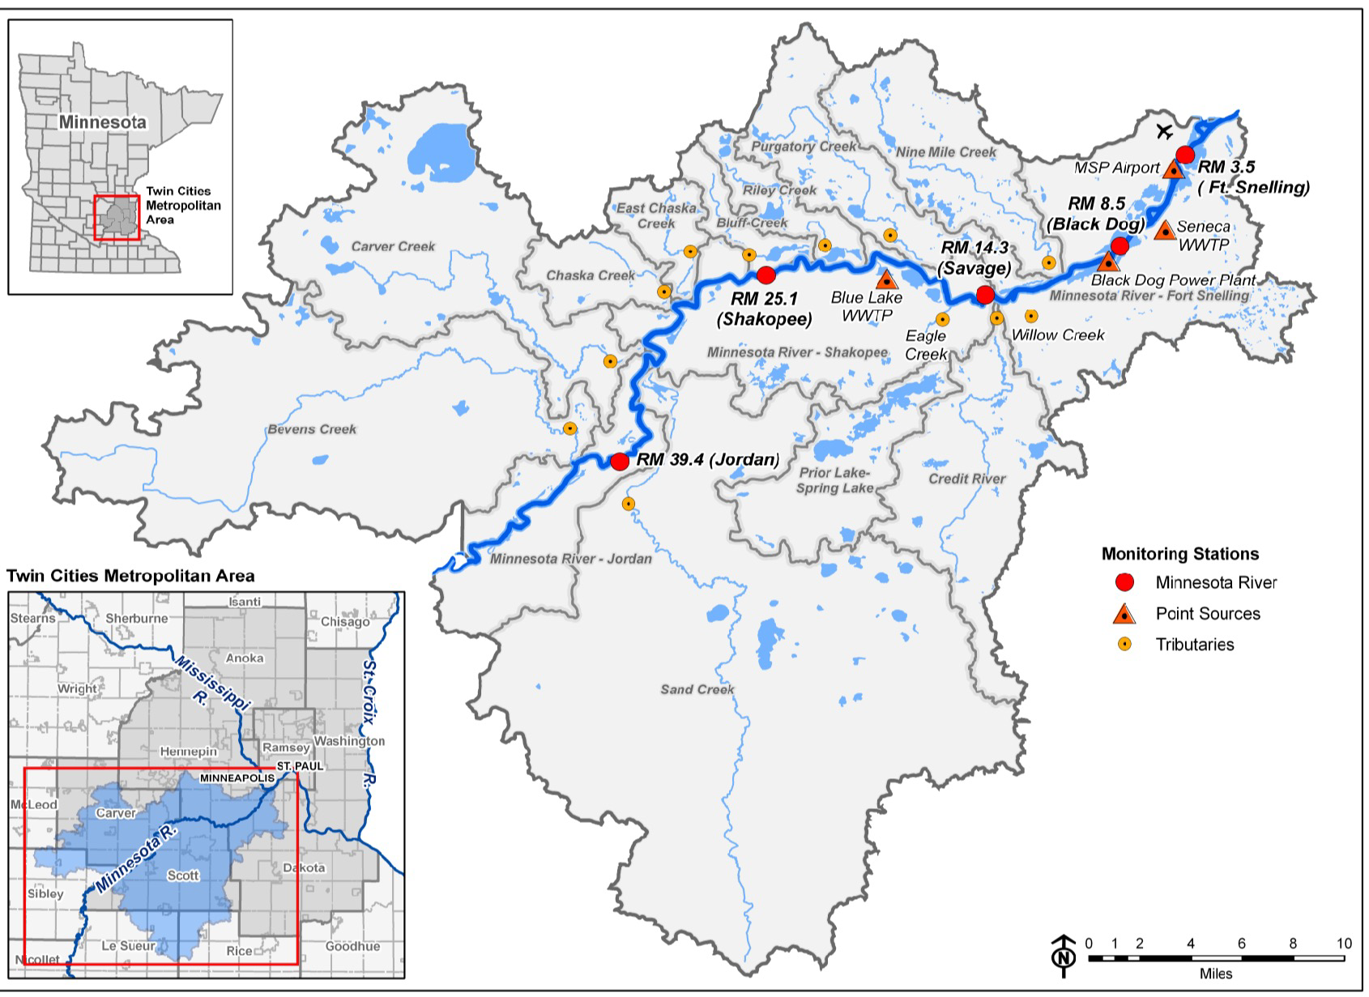
Case Study: Lower Minnesota River
Real application to Lower Minnesota River
Agricultural drainage basin
Low DO issues
RIVERINE CE-QUAL-W2 Application
Objectives
Obtain a copy of the model, and review inputs and structure
Modify model input as directed and save
Run Model
Evaluate preliminary results

Slide 4
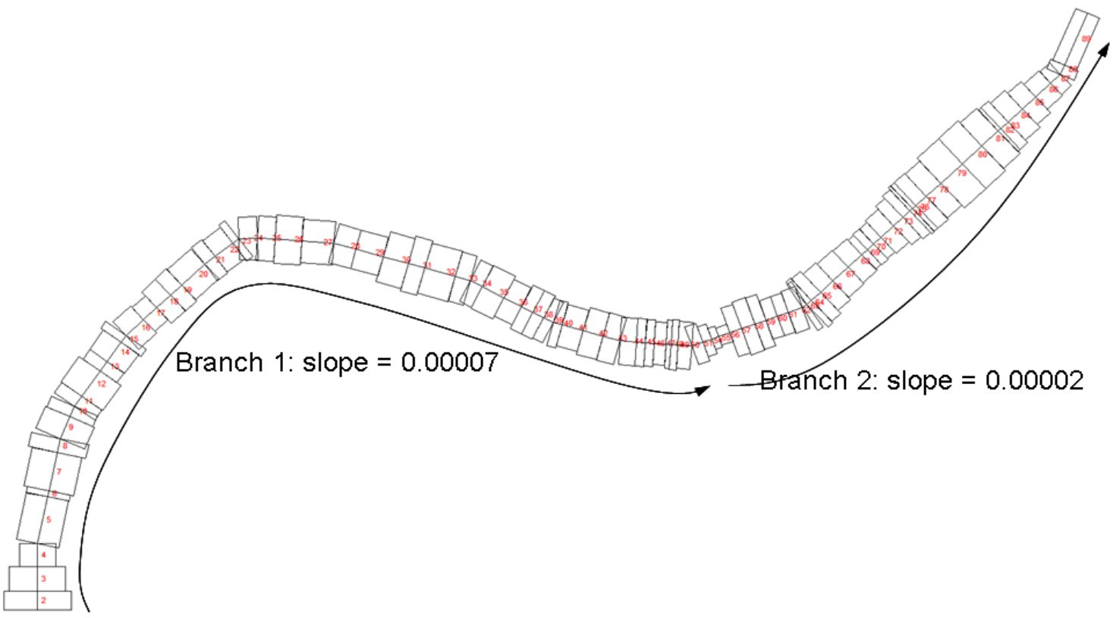
Case Study: Lower Minnesota River – CE-QUAL-W2
Original Application: CE-QUAL-W2 ver. 3.6, (Tammy Threadgill, 2016)
Important files
Bathymetry file
Boundary conditions
Flow files
Meteorological file
Control File
Each of the above may require modification/revision for application at a different time or under different conditions.
May want to work in a copy to prevent overwriting existing files

Slide 5
Bathymetry File
Typically, the bathymetry file is the first file to be developed.
Identifies the various geophysical components of model
Segment
Cross-sectional widths and heights
Bottom Elevation
Directional Orientation
Initial Water Surface Elevation
Friction
Reaches
Grouping of Segments
$
 | 1 | 2 | 3 | 4 | 5 | 6 | 7 | 8 | 9 | 10
DLX | 0 | 754.25 | 1002.72 | 953.04 | 1958.26 | 256.59 | 1611.46 | 575.54 | 973.17 | 474.71
ELWS | 214.66 | 214.66 | 214.6 | 214.54 | 214.45 | 214.25 | 214.23 | 214.147 | 214.1 | 214.05
PHI0 | 3.142 | 3.142 | 3.142 | 3.142 | 3.347 | 3.347 | 3.347 | 3.352 | 3.552 | 3.552
FRIC | 0.025 | 0.025 | 0.025 | 0.025 | 0.025 | 0.025 | 0.025 | 0.025 | 0.025 | 0.025
LAYERH
0.4 | 0 | 0 | 0 | 0 | 0 | 0 | 0 | 0 | 0 | 0
0.4 | 0 | 2669.88 | 2247.91 | 1458.85 | 1722.49 | 1750.51 | 2030.03 | 2343.38 | 2116.63 | 1996.8
0.4 | 0 | 2669.88 | 2247.91 | 1458.85 | 1722.49 | 1750.51 | 2030.03 | 2343.38 | 2116.63 | 1996.8
0.4 | 0 | 2669.88 | 2247.91 | 1458.85 | 1722.49 | 1750.51 | 2030.03 | 2343.38 | 2116.63 | 1996.8
0.4 | 0 | 2669.88 | 2247.91 | 1458.85 | 1722.49 | 1750.51 | 2030.03 | 2343.38 | 2116.63 | 1996.8
0.4 | 0 | 2669.88 | 2247.91 | 1458.85 | 1722.49 | 1750.51 | 2030.03 | 2343.38 | 2116.63 | 1996.8
0.4 | 0 | 2669.88 | 2247.91 | 1458.85 | 1722.49 | 1750.51 | 2030.03 | 2343.38 | 2116.63 | 1996.8
0.4 | 0 | 2669.88 | 2247.91 | 1458.85 | 1722.49 | 1750.51 | 2030.03 | 2343.38 | 2116.63 | 1996.8
0.4 | 0 | 2669.88 | 2247.91 | 1458.85 | 1722.49 | 1750.51 | 2030.03 | 2343.38 | 2116.63 | 1996.8

Slide 6
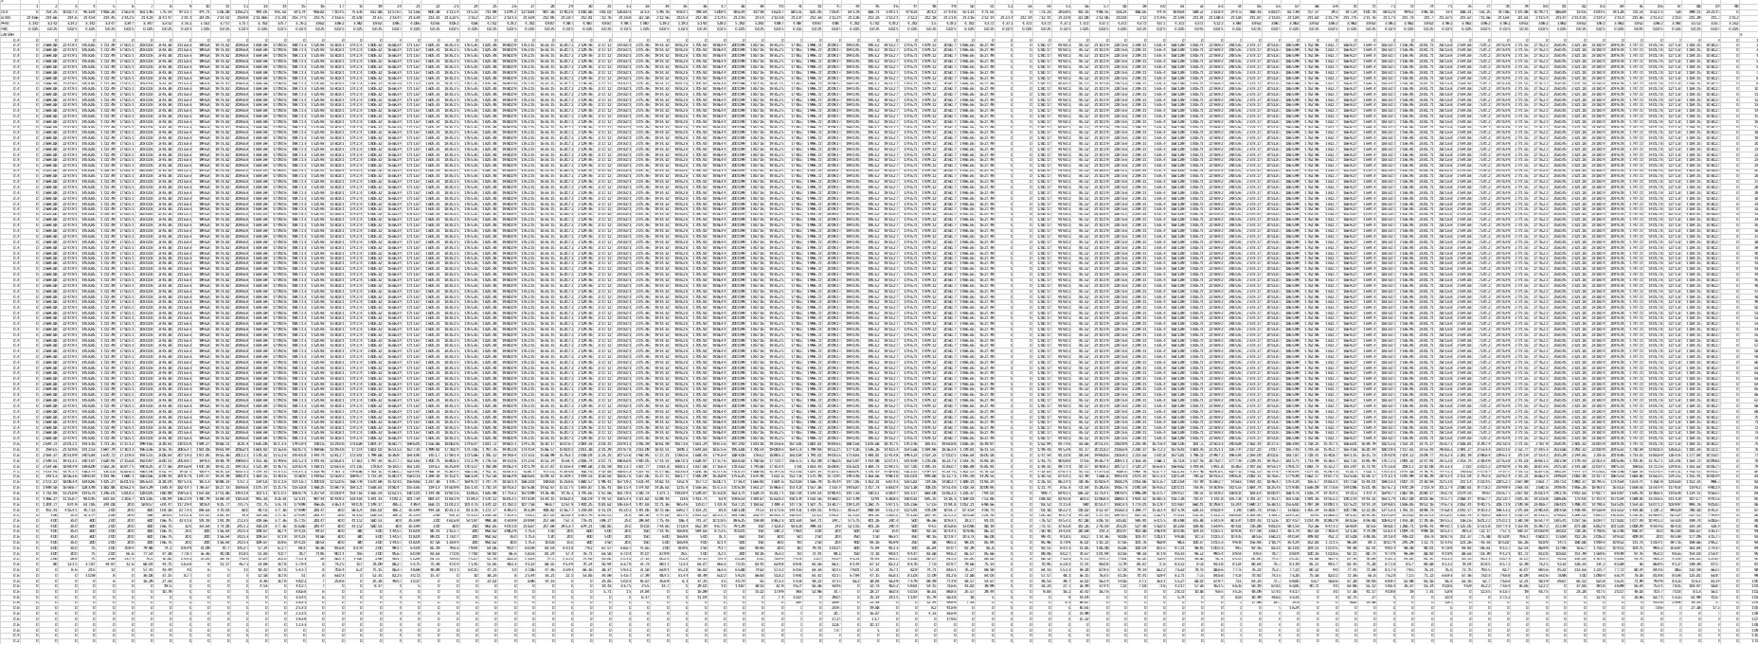
Bathymetry File: Full

Slide 7
Flow & Boundary Files
01QT355.INP
Mean daily flows, Sand Creek discharge near river mile 35.5, 10/01/00-9/30/01
Source: MCES
JDAY QIN Comment (e = estimated)
Generate Time Series files for all potential external flows entering the model
Frequency
Each requires corresponding temperature and concentration boundary conditions file
■ | 275.0 | .4475
■ | 276.0 | .4390
■ | 277.0 | .4786
■ | 278.0 | .2436
■ | 279.0 | .0283
■ | 280.0 | .0283
■ | 281.0 | .0283
TRIB PLACEMENT and TRIB FILES | TR1 | TR2 | TR3 | TR4 | TR5 | TR6 | TR7 | TR8 | TR9 | TR10
PTRC - Tributary inflow placement | DENSITY | DENSITY | DENSITY | DENSITY | DENSITY | DENSITY | DENSITY | DENSITY | DENSITY | DENSITY | DENSITY
TRIC - Interpolation control | OFF | OFF | OFF | OFF | OFF | OFF | OFF | OFF | OFF | OFF | OFF
ITR - Tributary inflow segment | 2 | 4 | 30 | 49 | 55 | 61 | 71 | 76 | 81 | 82 | 84
ELTRT - Top elevation if trib placement | 0 | 0 | 0 | 0 | 0 | 0 | 0 | 0 | 0 | 0 | 0
ELTRB - Bottom elevation if trib placement | 0 | 0 | 0 | 0 | 0 | 0 | 0 | 0 | 0 | 0 | 0
QTRFN - tributary flow file | 01QT355.INP | 01QT341.INP | 01QD205.I | 01QT137.I | 01QT125.I | 01QD107H.I | 01QD076H | 01QD065.I | 01QD041.I | 01QD038.I | 01QD030.I
TTRFN - tributary temperature file | 01TT355H.INP | 01TT341H.IN | 01TD205D | 01TT137H. | 01TT125H. | 01TD107H.I | 01TD076H | 01TD065D | 01TD041.I | 01TD038.I | 01TD030.I
CTRFN - tributary concentration file | 01CTR_355_RU | 01CTR_341_ | 01CTR_20 | 01CTR_137 | 01CTR_125 | 01CTR_107_ | 01CTR_076 | 01CTR_065 | 01CTR_041 | 01CTR_038 | 01CTR_030

Slide 8
Temperature Boundary Condition File
Mean hourly temperature, Sand Creek to MN river mile |  | 275.5417 | 16.40 e regression
35.5, 10/1/00-9/30/01 |  | 275.5833 | 16.80 e regression
Source: No measurements so estimated via |  | 275.6250 | 16.80 e regression
regression to Nine Mile Creek |  | 275.6667 | 16.90 e regression
JDAY | TIN Comment (e=estimated via regression) | 275.7083 | 16.80 e regression
275.0000 | 15.50 e regression | 275.7500 | 16.60 e regression
275.0417 | 15.30 e regression | 275.7917 | 16.40 e regression
275.0833 | 15.10 e regression | 275.8333 | 16.10 e regression
275.1250 | 14.90 e regression | 275.8750 | 15.70 e regression
275.1667 | 14.60 e regression | 275.9167 | 15.40 e regression
275.2083 | 14.40 e regression | 275.9583 | 15.20 e regression
275.2500 | 14.10 e regression | 276.0000 | 15.00 e regression
275.2917 | 14.00 e regression | 276.0417 | 14.60 e regression
275.3333 | 13.90 e regression
275.3750 | 14.00 e regression
275.4167 | 14.60 e regression
275.4583 | 15.20 e regression
275.5000 | 15.60 e regression

Slide 9
Water Quality Boundary Condition File
01CTR_355.NPT -- Sand Creek -- RM 35.5 -- WY01
Obtained from WY01_03 WQ Tributaries_TLT_RUN06.xls; updated LTI algal splits based on latest report
BODU
JDAY TDS ISS1 PO4 NH4 NO3 DSI LDOM RDOM LPOM RPOM 1C 2C 3C 4C 5C 6C ALG1 ALG2 ALG3
DO LDOP RDOP LPOP RPOP LDON RDON LPON RPON
275.000 506.21 | 27.00 | 0.180 | 0.020 | 1.600 20.500 | 0.134 | 0.759 | 0.134 | 0.759 | 0.00 | 0.00 | 0.00 | 0.0 | 0.00 | 0.00 | 1.240 | 0.383 | 0.133 10.970 |  | 0.001 | 0.004 | 0.001 | 0.004 | 0.007 | 0.038 | 0.007 | 0.038
306.000 517.32 | 26.00 | 0.220 | 0.020 | 1.900 20.500 | 0.134 | 0.759 | 0.134 | 0.759 | 0.00 | 0.00 | 0.00 | 0.0 | 0.00 | 0.00 | 1.477 | 0.209 | 0.069 11.840 |  | 0.001 | 0.004 | 0.001 | 0.004 | 0.007 | 0.038 | 0.007 | 0.038
336.000 515.49 | 28.00 | 0.210 | 0.030 | 2.000 20.500 | 0.134 | 0.759 | 0.134 | 0.759 | 0.00 | 0.00 | 0.00 | 0.0 | 0.00 | 0.00 | 1.730 | 0.008 | 0.008 14.600 |  | 0.001 | 0.004 | 0.001 | 0.004 | 0.007 | 0.038 | 0.007 | 0.038
367.000 527.66 | 27.00 | 0.240 | 0.420 | 2.300 20.500 | 0.129 | 0.729 | 0.129 | 0.729 | 0.00 | 0.00 | 0.00 | 0.0 | 0.00 | 0.00 | 1.636 | 0.010 | 0.102 14.830 |  | 0.001 | 0.004 | 0.001 | 0.004 | 0.006 | 0.036 | 0.006 | 0.036
398.000 515.49 | 28.00 | 0.210 | 0.020 | 2.000 20.500 | 0.134 | 0.759 | 0.134 | 0.759 | 0.00 | 0.00 | 0.00 | 0.0 | 0.00 | 0.00 | 1.297 | 0.069 | 0.389 14.830 |  | 0.001 | 0.004 | 0.001 | 0.004 | 0.007 | 0.038 | 0.007 | 0.038
426.000 517.00 | 27.00 | 0.210 | 0.940 | 2.100 20.500 | 0.134 | 0.759 | 0.134 | 0.759 | 0.00 | 0.00 | 0.00 | 0.0 | 0.00 | 0.00 | 1.087 | 0.078 | 0.589 14.830 |  | 0.001 | 0.004 | 0.001 | 0.004 | 0.007 | 0.038 | 0.007 | 0.038
457.000 328.06 | 205.00 | 0.170 | 0.180 | 6.100 19.100 | 0.193 | 1.093 | 0.193 | 1.093 | 0.00 | 0.00 | 0.00 | 0.0 | 0.00 | 0.00 | 2.853 | 0.048 | 0.609 14.830 |  | 0.001 | 0.005 | 0.001 | 0.005 | 0.010 | 0.055 | 0.010 | 0.055
487.000 347.37 146.00 |  | 0.170 | 0.040 | 5.400 19.100 | 0.171 | 0.971 | 0.171 | 0.971 | 0.00 | 0.00 | 0.00 | 0.0 | 0.00 | 0.00 3.309 |  | 0.075 | 0.126 10.970 0.001 0.005 0.001 0.005 0.009 0.049 0.009 0.049
518.000 372.39 206.00 |  | 0.200 | 0.030 | 6.200 19.000 | 0.188 | 1.063 | 0.188 | 1.063 | 0.00 | 0.00 | 0.00 | 0.0 | 0.00 | 0.00 3.019 |  | 0.175 | 0.248 10.470 0.001 0.005 0.001 0.005 0.009 0.053 0.009 0.053
548.000 447.64 | 70.00 | 0.190 | 0.030 | 2.600 19.700 | 0.150 | 0.850 | 0.150 | 0.850 | 0.00 | 0.00 | 0.00 | 0.0 | 0.00 | 0.00 | 1.936 | 0.301 | 0.193 | 8.600 | 0.001 | 0.004 | 0.001 | 0.004 | 0.008 | 0.043 | 0.008 | 0.043
579.000 507.94 | 27.00 | 0.200 | 0.020 | 1.900 20.500 | 0.134 | 0.759 | 0.134 | 0.759 | 0.00 | 0.00 | 0.00 | 0.0 | 0.00 | 0.00 | 1.432 | 0.200 | 0.123 | 8.550 | 0.001 | 0.004 | 0.001 | 0.004 | 0.007 | 0.038 | 0.007 | 0.038
610.000 499.23 | 25.00 | 0.200 | 0.020 | 1.800 20.500 | 0.134 | 0.759 | 0.134 | 0.759 | 0.00 | 0.00 | 0.00 | 0.0 | 0.00 | 0.00 | 1.440 | 0.192 | 0.123 | 9.700 | 0.001 | 0.004 | 0.001 | 0.004 | 0.007 | 0.038 | 0.007 | 0.038
641.000 513.58 | 25.00 | 0.200 | 0.020 | 1.900 20.500 | 0.112 | 0.633 | 0.514 | 2.913 | 0.00 | 0.00 | 0.00 | 0.0 | 0.00 | 0.00 | 1.247 | 0.376 | 0.132 | 11.360 | 0.001 | 0.003 | 0.003 | 0.015 | 0.006 | 0.032 | 0.026 | 0.146

Slide 10
Meteorological File
Hourly (plus) meteorological data, MSP Intl Airport near river mi 3; updated 06/01/2009 Source: MDNR except solar from UM, St. Paul Campus; TLT added cloud cover from 14WS
JDAY TAIR TDEW WIND PHI CLOUD SRO
One file
Daily or more frequent, depending upon issues
Important to capturing what is happening “in” the model at a given time
275.000 23.900 10.000 3.600 2.600 8.0 0.000
275.037 22.800 8.900 5.100 2.600 8.3 0.000
275.079 22.800 8.900 6.200 3.000 8.6 0.000
275.120 22.200 8.900 6.700 3.100 8.9 0.000
275.162 21.100 9.400 6.700 3.500 9.1 0.000
275.204 21.700 9.400 7.700 3.700 9.4 0.000
275.245 21.100 8.900 5.700 3.700 9.7 0.000
275.250 21.100 9.400 6.200 3.700 10.0 23.012
275.287 20.000 10.000 6.200 3.700 9.9 23.012
275.329 18.900 10.000 5.100 3.700 9.7 88.560
275.370 17.200 10.000 3.600 3.700 9.6 128.307
275.412 16.100 10.000 1.500 3.050 9.4 355.633
275.454 14.400 10.000 3.600 2.400 9.3 433.733
275.495 13.900 10.000 3.100 2.300 9.1 278.231
275.500 14.400 10.000 3.100 2.300 9.0 370.974
275.537 13.900 10.600 3.100 2.400 9.0 370.974
275.579 15.000 10.600 3.100 2.600 9.0 175.725
275.620 16.100 10.600 4.100 3.100 9.0 149.924
275.662 18.300 11.100 4.100 2.600 9.0 56.483
275.704 20.000 11.100 4.600 3.000 9.0 28.590
275.745 21.100 11.100 3.050 2.720 9.0 9.763
275.750 20.600 11.100 1.500 2.440 9.0 0.000
275.787 22.200 11.700 3.100 2.160 9.0 0.000
275.829 22.200 11.700 0.000 1.880 9.0 0.000
275.870 23.300 11.700 5.100 1.600 9.0 0.000
275.912 22.200 11.700 2.600 3.000 9.0 0.000
275.954 22.800 11.700 2.600 1.950 9.0 0.000
275.995 22.200 12.200 3.600 0.900 9.0 0.000
276.000 21.700 12.200 3.600 0.900 9.0 0.000

Slide 11
Control File
This file contains specifications of much of the information that controls model operation
Fill in these with real date | DLT CON | NDLT | DLTMIN | DLTINTER
TMSTRT | Time step control parameters | 7 | 0.1 | OFF
10/1/2000 0:00
TMEND | DLT DATE | DLTD | DLTD | DLTD
10/1/2001 0:00 | Date of time step change in JDAY | 275 | 277 | 457
275.000
640.000 | DLT MAX | DLTMAX | DLTMAX | DLTMAX
Year 2000 | Maximum time step in seconds | 100 | 75 | 75
Go to Index of Sheets: | DLT FRN | DLTF | DLTF | DLTF
Index of Sheets'!A1 | Fraction of maximum theoretical time step | 0.4 | 0.4 | 0.4

Slide 12
After Model is Initially Set Up
Run the W2 preprocessor
Address what Errors the pre-processor identifies.
Once addressed, re-run W2 pre-processor, and continue until there are no Errors.
Evaluate Warnings to see if they warrant changes or modifications.
Compare computed Volume Elevation curve to official curve if available.
If results are not satisfactory, adjust the bathymetry, and start the process again.

Slide 13
After W2 Preprocessor is Finished
Run CE-QUAL-W2 model
Review model output
“w2.wrn” file
Time Series files
Evaluate model performance.
Did it appear to operate as you desired?
Address issues that develop……..

Slide 14
Exercises: Model Simulation 1
Short Duration Simulation:
Modify W2 Control file to adjust model simulation duration to 3 months (90 days).
Adjust model time step in W2 Control file by changing DLTMIN from 0.1 to 1.
Change NDLT from 7 to 1.
Try different schemes.
TRANSPORT SCHEME | WB1
SLTRC - UPWIND, QUICKEST, ULTIMATE - use ULTIMATE | ULTIMATE
THETA - degree of implicitness - use 0.55 - Time-weighting for vertical advection scheme | 0.5
HYD COEFFICIENTS | WB1
AX - Longitudinal eddy viscosity, m2/s | 1
DX - Longitudinal eddy diffusivity/conductivity, m2/s | 1
NDLT | DLTMIN
7 | 0.1

Slide 15
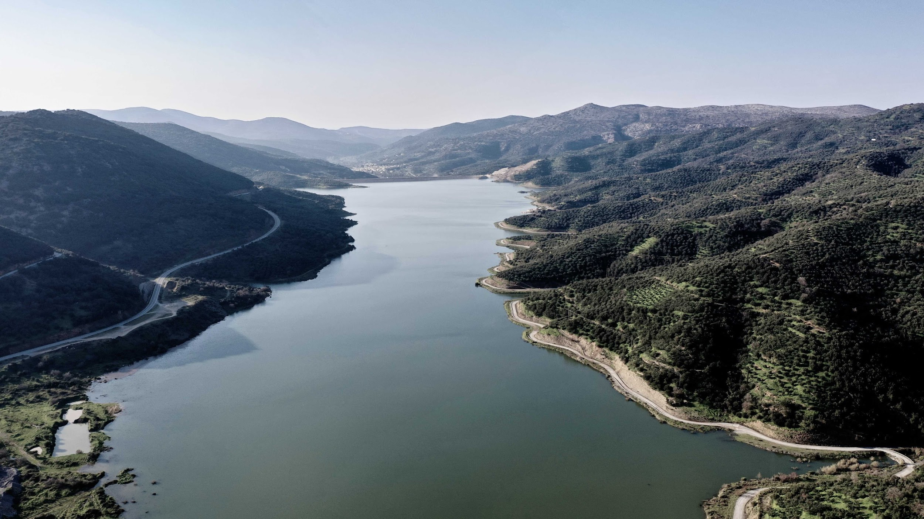
Questions?

